Slide 1
Spicy Broast Web
Shaibal Das 011131143
Irine Parvin 011132095
Muhammad Ali 011133042
Yeazullah Aziz 011141022

Slide 2
Class Diagram

Slide 3
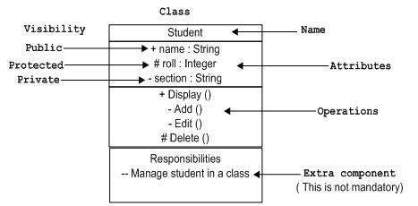
Class Diagram
Describes the structure of a system by showing the system’s
-classes & their attributes
-operations
-the relationship between them
Attributes and methods can be
Private –
Protected #
Public +

Slide 4
Spicy Broast
Waiter Cook Manager Customer
-login() -logout () +search()
M
1
Waiter
-Id : int -password : string
+serveOrder()
Cook­­
- ID : int - pass : string
+ foodComplete() +getter() +setter()
1
M
1
1
M
M
Menu
+item_menu +item_price #item_id
1
M
M
Customer
-id : int -Name : String -Phone : string -Adress : string
+order() +menu() eventOrder() +payment()
Manager
-id : int -password : string
+getPayment()
1
M
M
Order
-id : int -bill : int
-queueCook () +autoBIll() +autoSlip()
Delivery
-D_Man_id : int -D_Man_pass : string
#delivaryToCustomer
M
M
1
1
M
M
M
M
M
Payment
-order_id
#paymentSlip()
M
1
1
Slip
-order_id : int -Bill : int -customer_name: string
1
M

Slide 5
State Diagram

Slide 6
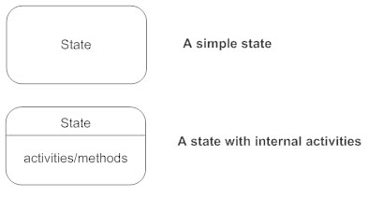
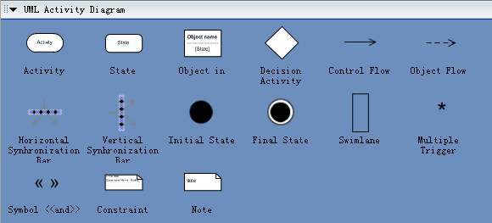
State Diagram
Describe
-all possible state of an object when an event occur

Slide 7
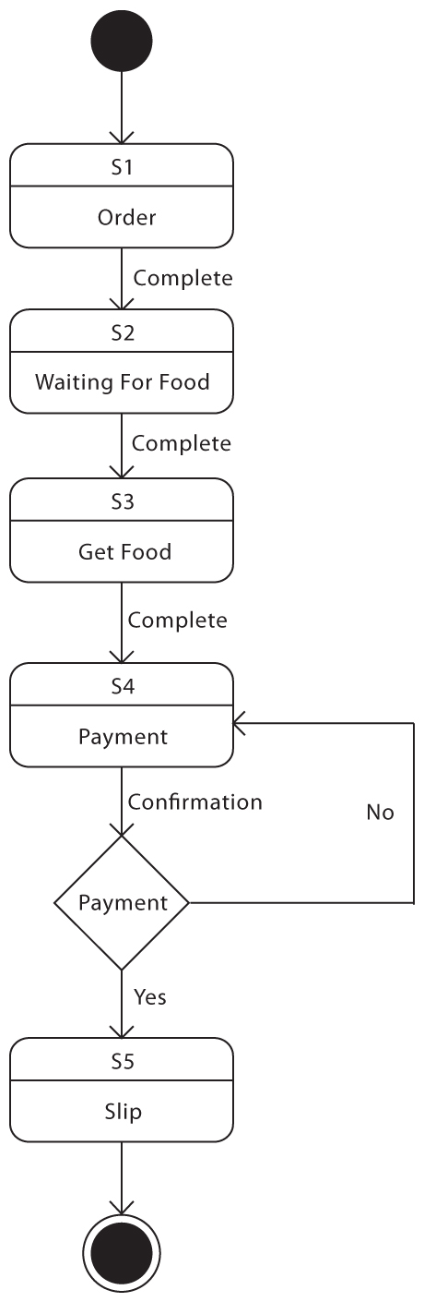
Order State Diagram

Slide 8
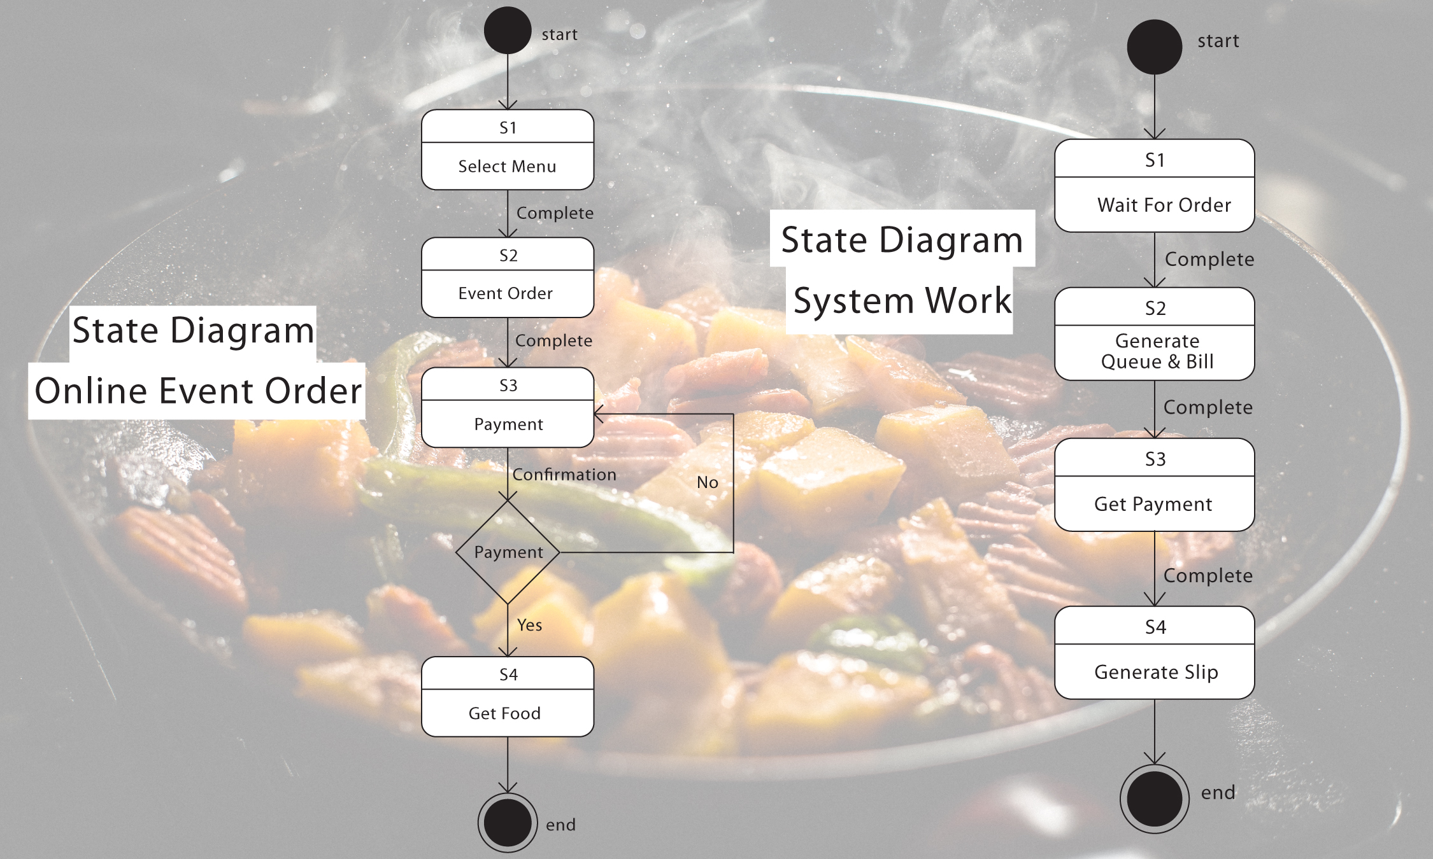

Slide 9
Sequence Diagram

Slide 10
Sequence Diagram
Describe
-how objects operate with one another and in what order.
It is a construct of a message sequence chart.
A sequence diagram shows object interactions arranged in time sequence.

Slide 11
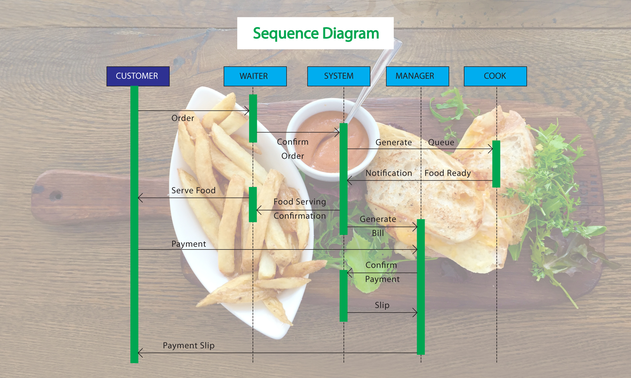
Sequence Diagram

Slide 12
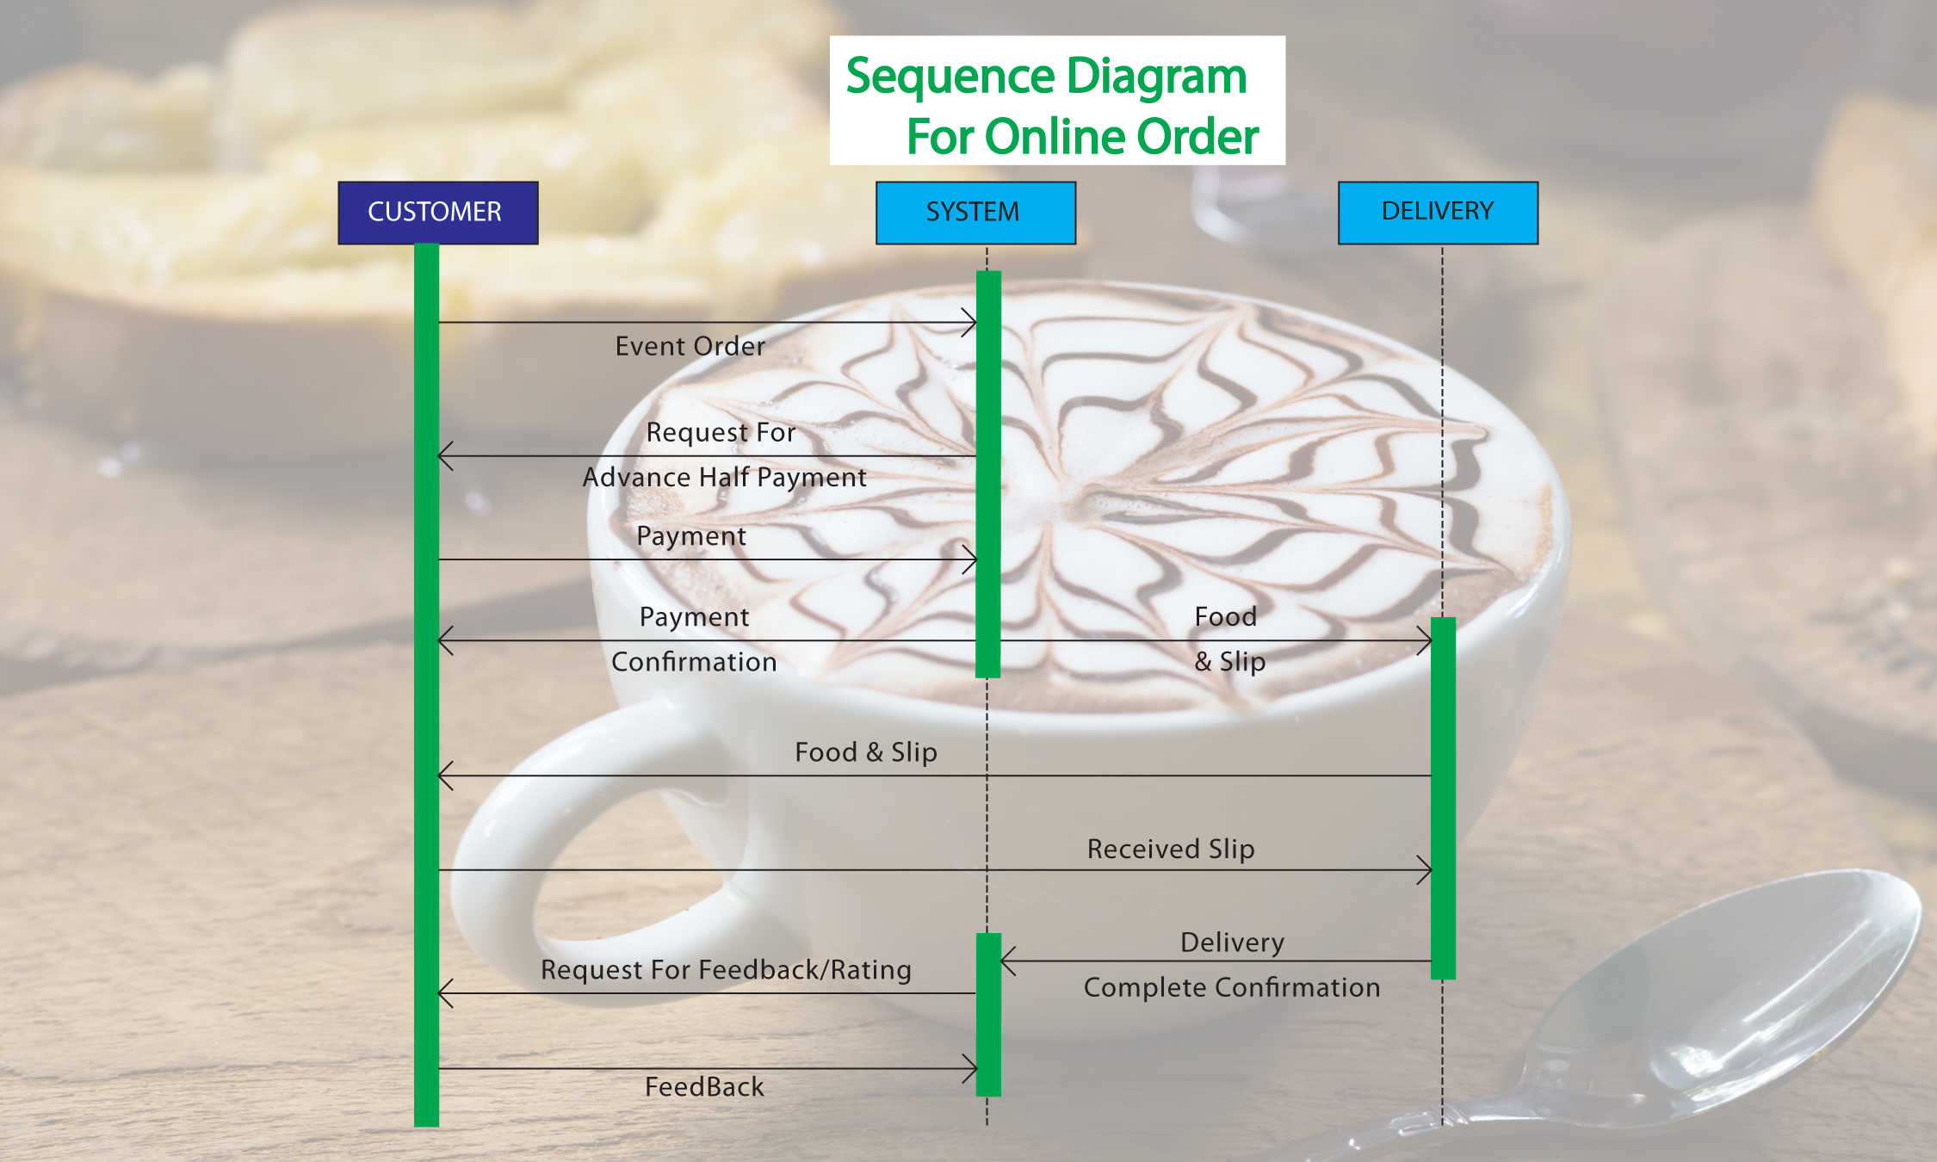
Seuence Diagram

Slide 13
CRC Diagram

Slide 14
CRC Diagram
Customer
Knows Menu Knows address Place orders Confirm payment Get food | Waiter Manager Menu Delivery Payment
Cook
Receive order form queue Prepare food Deliver to waiter | Order
Manager
Generate order bill Receive payment and deliver slip | Customer Order

Slide 15
Deployment Diagram

Slide 16
Deployment Diagram
Deployment diagrams are used to visualize the topology of the physical components of a system where the software components are deployed.

Slide 17
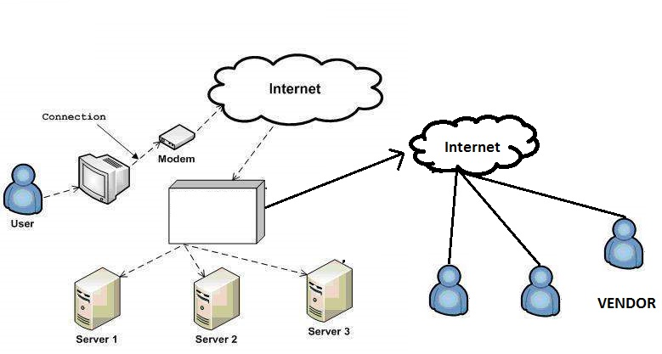
Deployment Diagram

Slide 18
UI Design 3 Golden Rules
1. Place users in control.
2. Reduce user’s Memory load.
3. Make the Interface Consistent.

Slide 19


